Slide 1



What if papers didn't define our story?
John: Skilled developer overlooked due to resume inconsistencies
Esinam: Talented seamstress excluded due to lack of formal certification
Proof of skill should live on-chain, vouched by community.

Slide 2




The Problem
Skills undervalued without certifications
Resumes are gamed, trust is broken
Millions of workers locked out of real opportunities
Companies waste resources filtering unreliable talent

Slide 3




The Solution
On-chain, verifiable work reputation
Community-backed endorsements instead of centralized institutions
Simple wallet = instant profile
Decentralized hiring for all: from coders to cooks

Slide 4


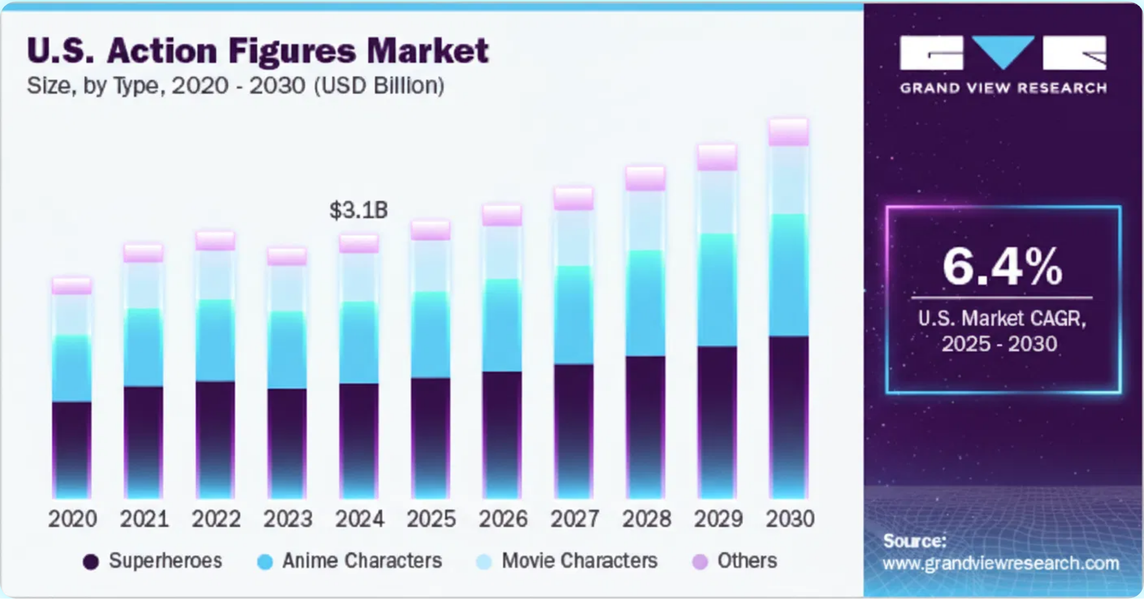
The Market
Freelance economy:
$13.8 B+
and growing
Blue-collar/local services: multi-billion untapped opportunity
HireX = bridge between Web3 verification and gig economy

Slide 5






Revenue Streams
Transaction fees on contracts
Premium profiles & boosted listings
Business/community accounts for scaling
Aggregated workforce insights

Slide 6


Why Now
Decentralized identity is maturing
Web3 adoption beyond just developers
Communities demand trust + transparency
Early mover advantage in 'proof-of-skill' economy

Slide 7


Build your resume on-chain
Empower individuals. Strengthen communities. Redefine trust in hiring.
Join us in shaping the future of work

